Slide 1



Writing a Comprehensive Sales Messages

Slide 2


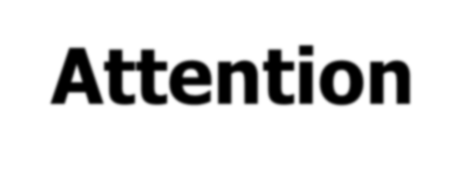
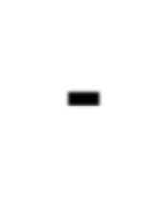
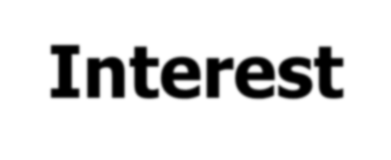
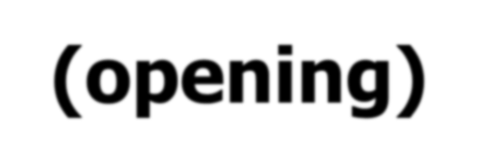

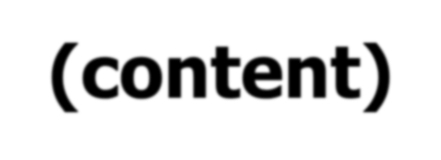




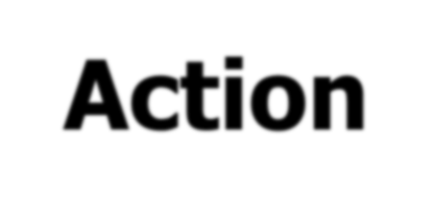
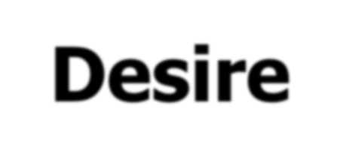
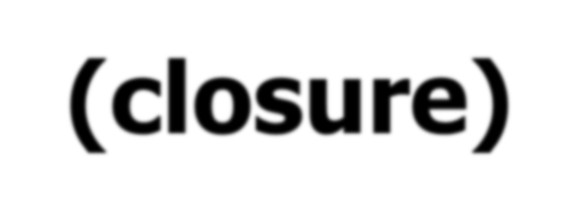


Attention- (opening)
Interest- (content)
AIDA PLAN
Action- (closure)
Desire- (content)
© 2005 Pearson Education Canada Inc

Slide 3

Attention - Introduction of the product
The heading is the first item (content) the audience sees on your sales letter/brochure
You can be slightly provocative and bold
For example:
Why are you still wasting your time with your boring & old-fashioned vacuum cleaner?
Let us deal with all the hassle!
The aim is to introduce your product

Slide 4
Examples:
A specific trait shared by the audience:
e.g. "Busy executives like you need a good kitchen assistant!
A solution to a problem:
e.g: "Tired of cold air rushing through the cracks around your windows? Stay warm and save energy with AAA Weather-stripping.“
**Think of a way to attract your audience to read your Sales Message
song?
Images?

Slide 5

You have now caught the recipient's attention. What you have to do next is to make your audience clear of the product that you are offering.
You have to provide complete information of the product to your audience i.e. features, and etc.

Slide 6
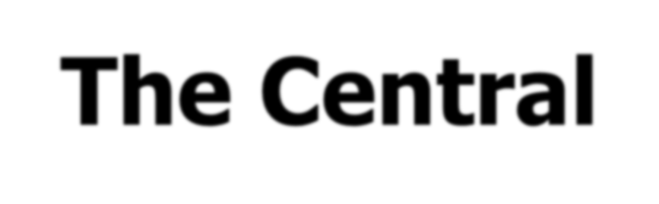



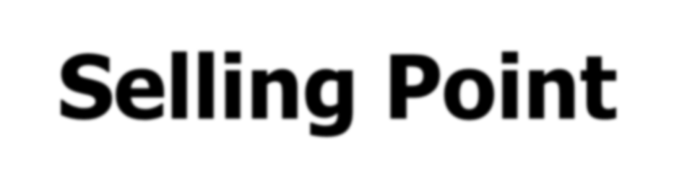

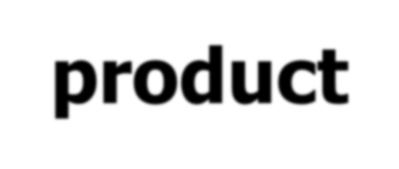
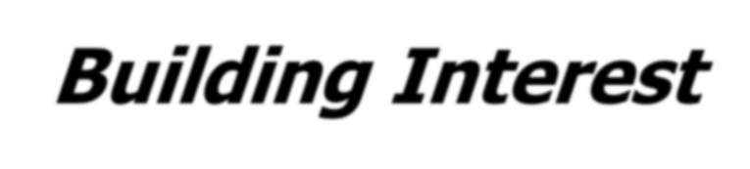

Provide Essential Details
B
u s in
ess
C
o m
m
u n icatio
n E
s s en
tials
Know the Product
© 2005 Pearson Education Canada Inc

Slide 7
DESIRE
You have now provide the clear content of the product to your audience. What you have to do next is to provide evidence/proof of your product’s efficiency.
Your aim for this section is to persuade your audience based on the evidence(s) given.

Slide 8
INCREASING DESIRE
Study the competition (show comparison)
Support your claim with data (figures, statements and etc.,)

Slide 9


You have now provide the clear content and evidence to your audience. What you have to do next is to provide actions or steps that they need to take if they need to:
- know more about your product
- place an order of your product

Slide 10

USING POSTSCRIPT
P.S is useful as the last attention grabber as writer will put this element at the last part of the sales message (after Action).
The major advantage of using P.S is to grab the audience attention by providing “extra” content in order to catch their attention on the product.

Slide 11

USING POSTSCRIPT
P.S: 15% off for the first 100 customers!
P.S: By purchasing this product by 30 November 2026, you are entitled for ....................!
P.S: FREE SERVICE (5 months) for the first 200 customers!

Slide 12


Attention | Make your audience want to know about your idea. Find some common ground on which to build your case. Try to attract their attention.
Interest | Explain the relevancy of your message to your audience. Explain in detail about your product.
Desire | Make audience members want to change their opinion by explaining how the change will benefit them. Back up your claims/support your claim with evidence.
Action | Suggest actions that you want readers to take. Remind readers of the benefits of taking action, and make the action easy.

Slide 13
Please take note that your Sales Letter (ASG 2) should be organized as a formal letter (LETTER FORMAT IS REQUIRED)

